Slide 1

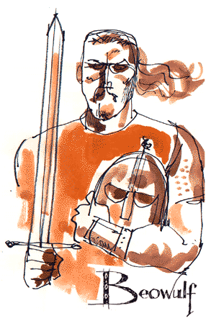

Beowoulf and Heroic Ideals
Week -4
Assist. Prof. Dr. Pelin GÖLCÜK MİRZA

Slide 2
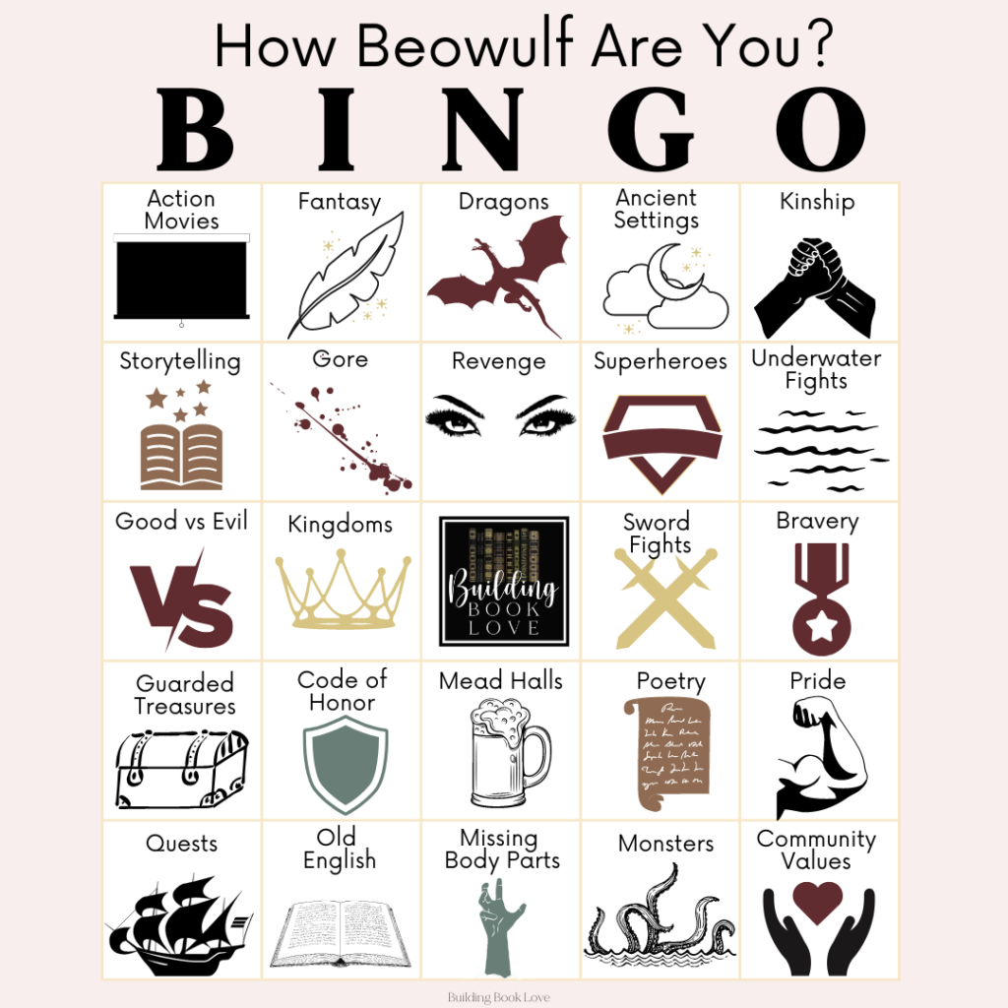

Slide 3
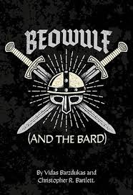
Intro to Beowulf
It is a heroic narrative
30,000 lines of Anglo-Saxon poetry survive today
It concerns the deeds of a Scandinavian prince, Beowulf
Author - Unknown, probably a monk
Composed between 750’s – 1000’s
Oldest surviving English poem

Slide 4
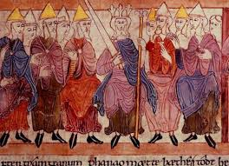
Reflection/Production of Anglo-Saxon Culture
After the Anglo-Saxon invasion, Germanic society had shaped the British culture.
They were organized by families (chief, kinsmen, family, independent political entities )
Accumulated treasures amount to success
Fame and fortune zealously sought after
Loyalty to one’s leader crucial
Importance of pagan, Germanic, and Christian ideals
to people whose lives were often hard and uncertain

Slide 5
Heroic Ideals for Perfection
Strive to do better than anyone else
Sail a ship (whale-road) through storm
Swim a river or bay
Tame a horse
Choose the best campsite
Set firm defenses
Successfully lead his people in battle
Plow a field
Build a hall
FIGHT
Skill and courage
The ideal was for kings but male members tried to imitate it.

Slide 6

Anglo-Saxon Culture
Fierce, hardy life of warrior and seamen
Strength, courage, leadership abilities appreciated
Boisterous yet elaborately ritualized customs of the mead-hall
Expected the hero to boast

Slide 7
Anglo-Saxon Ideals
Codes of Conduct
Good defeats evil
“Wergild”--restitution for murder or expect revenge from victim’s relatives
Boasts must be backed with actions.
Fate is in control (“wyrd”)
Fair fights are the only honorable fights

Slide 8
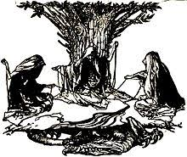
Three Norns:Spinners of the Web of Time
«Wyrd» is the concept that everything in the universe is connected in a beautiful web that stretches through time. It is the thread of fate and destiny.
Ygdrassil
*moirai in greek mythology

Slide 9
Epic Poem
Long narrative poem that recounts the adventures of a hero.
Elevated language
Does not sermonize
Invokes a muse
Begins in media res
Mysterious origin, super powers, vulnerability, rite of passage

Slide 10
The Epic Hero
Actions consist of responses to catastrophic situations in which the supernatural often intervenes.
Code of conduct forces him to challenge any threat to society
Destiny discovered through a series of episodes punctuated by violent incidents interspersed with idyllic descriptions.

Slide 11
Elements of Anglo-Saxon Poetry/Old English Poetry
Chant-like effect of the four-beat line
Alliteration (“Then the grim man in green gathers his strength”)
Caesura-pause or break in a line of poetry (“Oft to the wanderer weary of exile”)
Kenning-metaphorical phrase used instead of a name (“battle-blade” and “ring-giver”)
Epithet-description name to characterize something (“keen-edge sword”)
Hyperbole-exaggeration

Slide 12
Title of the Poem
Anglo-Saxon word Beo means “bright” or “noble”
Anglo-Saxon word wulf means “wolf”
Beowulf means bright or noble wolf
Other sources say Beo means “bear”

Slide 13
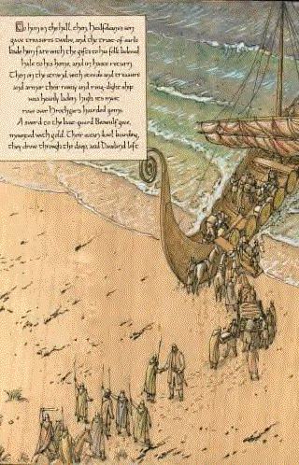
The Poetry in Beowulf
2. Kennings
Compound metaphor (usually two words): Kennings combine two words to create an evocative and imaginative alternative word. By linking words in this way, the poets were able to play and experiment with the rhythm, sounds and imagery of the poetry. Beowulf contains over a thousand kennings.
b. Most were probably used over and over
For instance: hronade literally means “whale-road,” but can be translated as “sea”

Slide 14
In off the moors, down through the mist-bands
God-cursed Grendel came greedily loping.
The bane of the race of men roamed forth,
hunting for a prey in the high hall.
Under the cloud-murk he moved towards it
until it shone above him, a sheer keep
of fortified gold. Nor was that the first time
he had scouted the grounds of Hrothgar's dwelling -
although never in his life, before or since,
did he find harder fortune or hall-defenders.
Spurned and joyless, he journeyed on ahead
and arrived at the bawn. The iron-braced door
turned on its hinge when his hands touched it.
From Seamus Heaney’s translation of ‘Beowulf’

Slide 15
Kennings
Some well-known Anglo-Saxon kennings include:
  bone-house (banhus ) - the human body
  battle-light (beadoleoma) - sword
  wave-floater (wægflota) – ship
Descriptions of the sea included:
  whale road (hronrad)
  fish home (fiscesethel)
  seal bath (seolbæp)

Slide 16
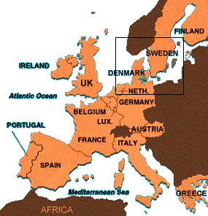
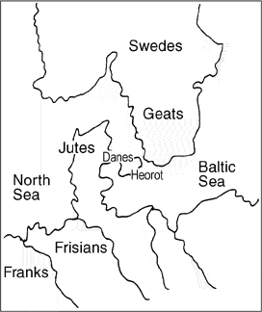
Setting: Beowulf’s time and place
Europe today
Time of Beowulf

Slide 17

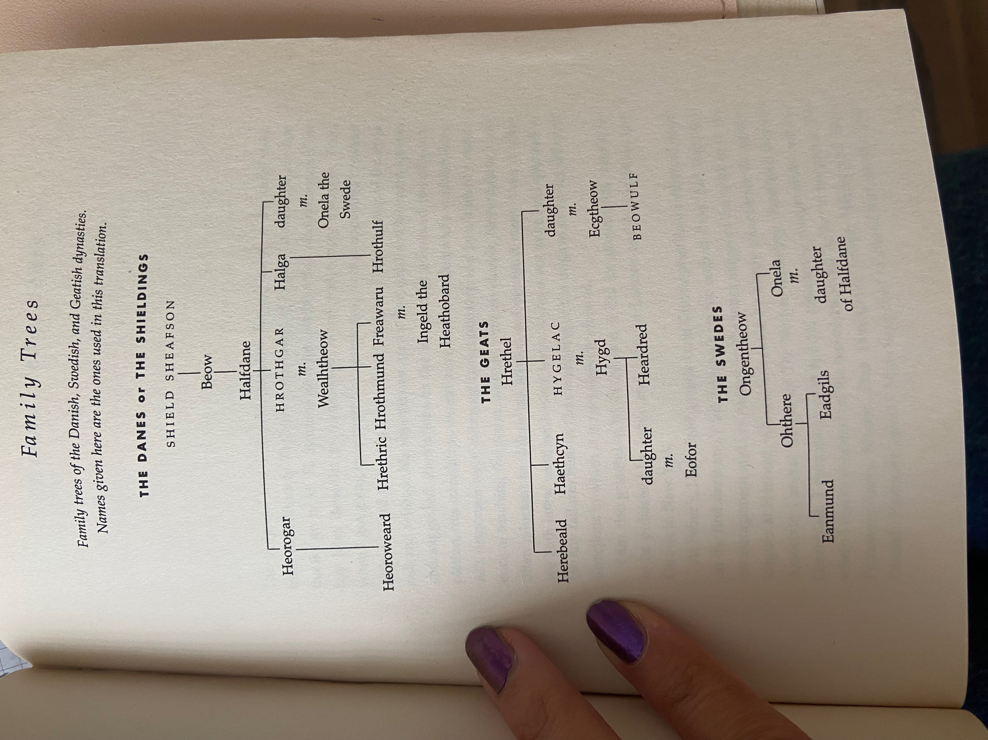

Slide 18
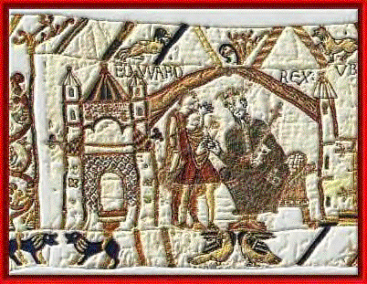
Oral tradition
Minstrels: singers
Scop:
A bard or story-teller.
The scop was responsible for praising deeds of past heroes, for recording history, and for providing entertainment

Slide 19
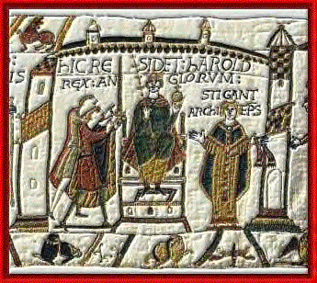
Thane and Mead-Hall
thane
A warrior
mead-hall
The large hall where the lord and his warriors slept, ate, held ceremonies, etc.

Slide 20
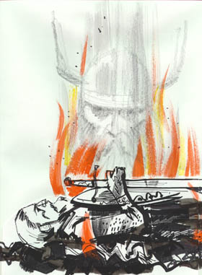
Main Characters

Slide 21
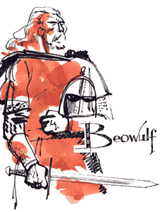
Beowulf
Epic hero
Geat (from southern Sweden)
Nephew of Higlac (King at story’s start)
Sails to Denmark to help Hrothgar

Slide 22
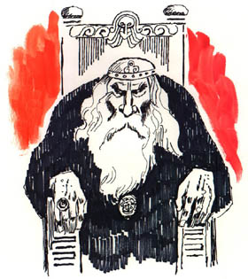
Hrothgar
Danish king
Builds Herot (banquet hall) for men
Tormented by Grendel for 12 years
Loses many men to Grendel
Joyless before Beowulf’s arrival

Slide 23
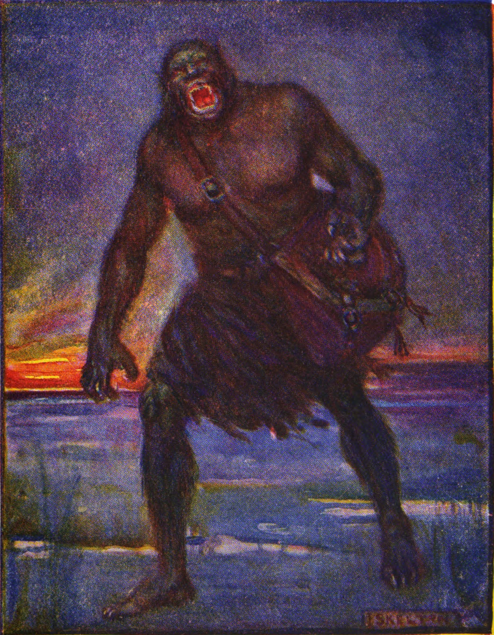
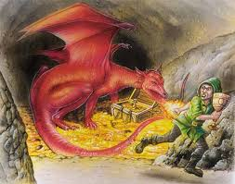
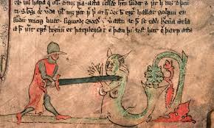
Three monsters:
Grendel
Grendel’s mother
Dragon

Slide 24
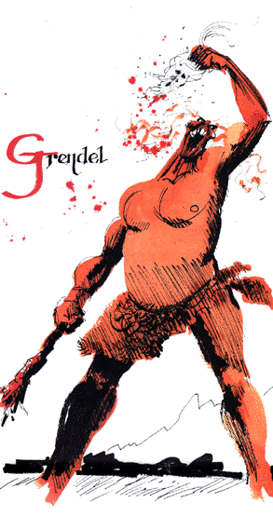
Grendel
Referred to as demon and fiend
Haunts the moors (swampy land)
Descendant of Cain
Feasts on 30 men the night of 1st attack

Slide 25
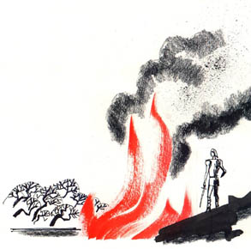
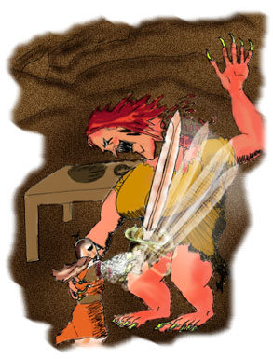
Grendel’s Mother
Referred to as she-wolf
Lives under the lake by Heorot Mead Hall
Challenges Hrothgar when she kills one of his best men

Slide 26
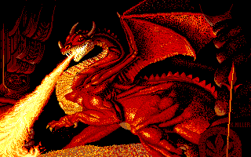
Fire Dragon
Lives in Beowulf’s kingdom
Wakes up when thief steals cup
Guards countless treasures

Slide 27
Topics to Consider*
Heroism
Portrayal of monsters as others
Depiction of society
Transition from paganism to christianity
Violence
Treasure
The role of oral tradition
Death
*Please take notes the discussion that we will have in the classroom. You will be expected to have ability to make comments on Beowulf in regards to these main issues.

